Slide 1
AME20216 - Lab I L8 – Solar Energy

Slide 2
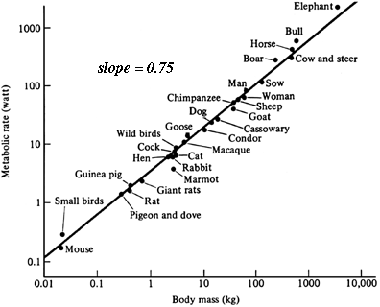
Kleiber’s Law: Metabolism vs. Mass
http://eesc.columbia.edu/courses/ees/life/lectures/lect03.html

Slide 3

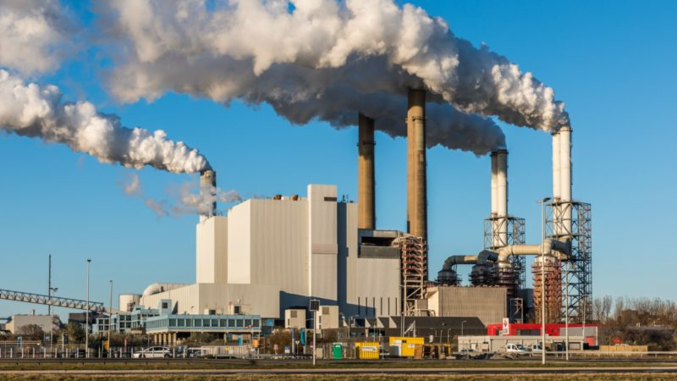
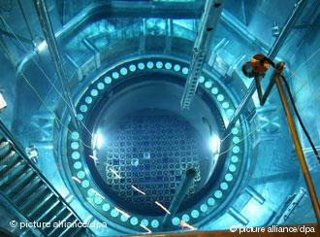
Energy Consumption
Human metabolism ~ 100W
Human “social metabolism” ~ 10,000W

Slide 4
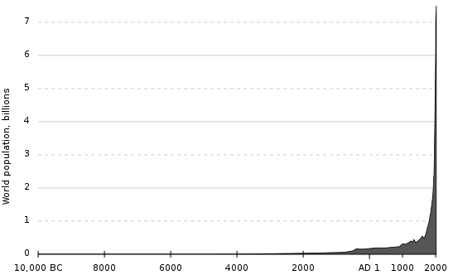
Energy Consumption
Population over 7 billion and growing!
https://en.wikipedia.org/wiki/Human_overpopulation#/media/File:Population_curve.svg

Slide 5
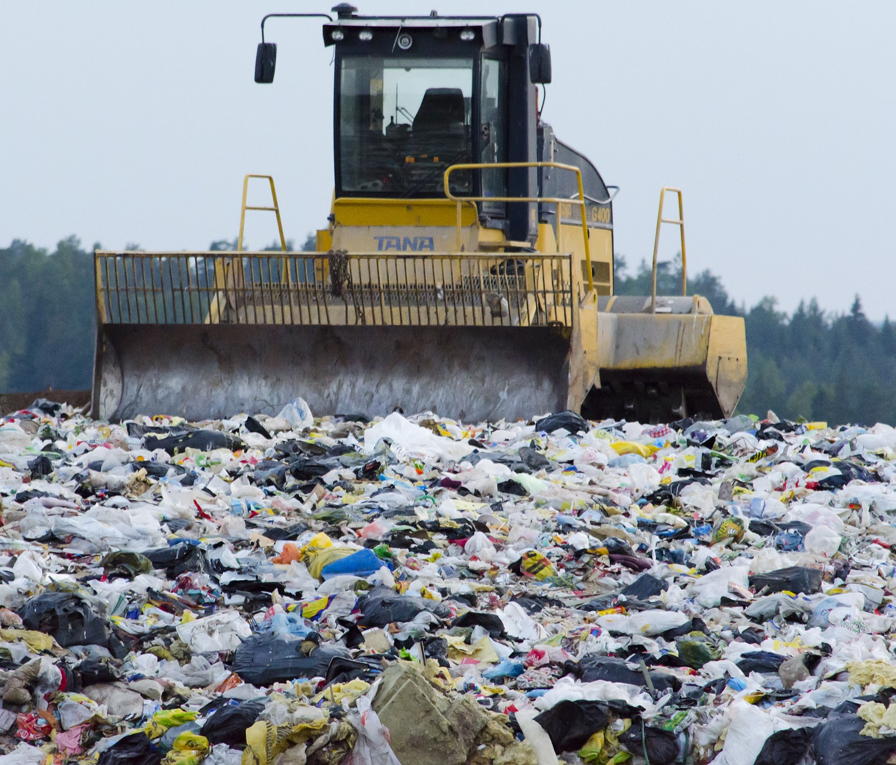
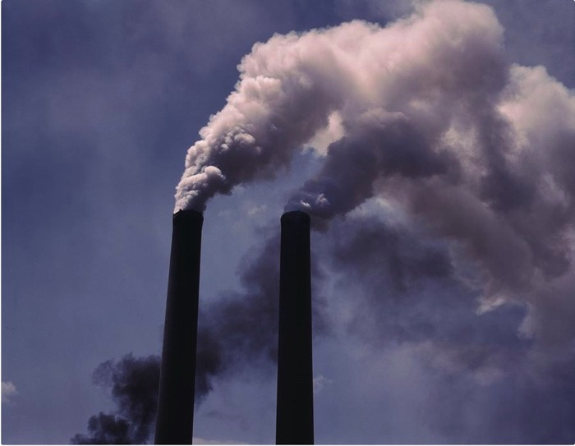
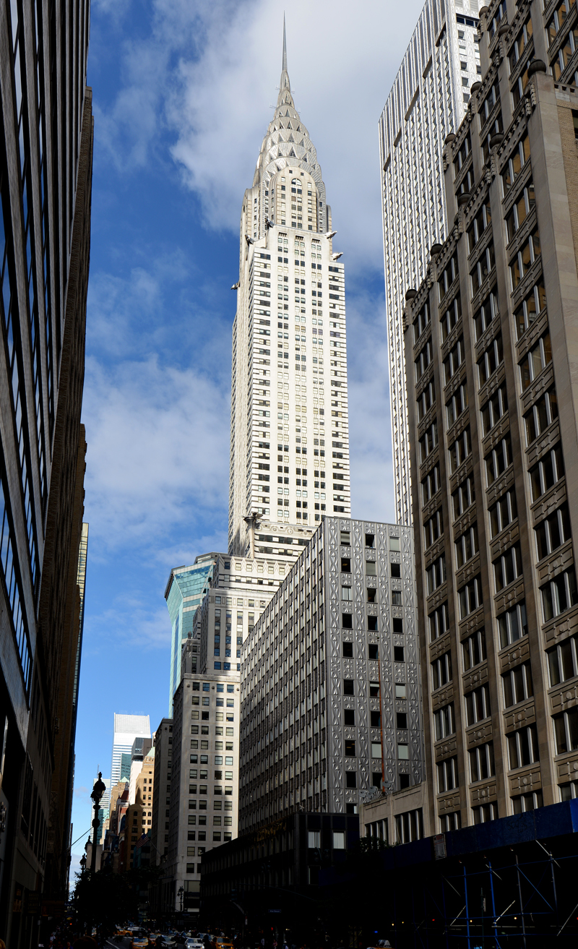

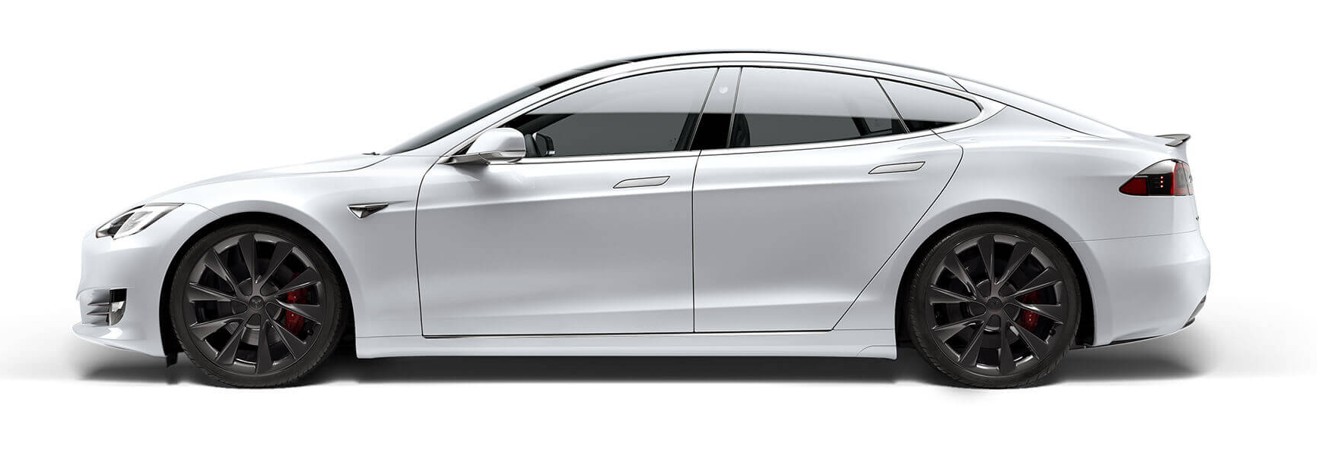
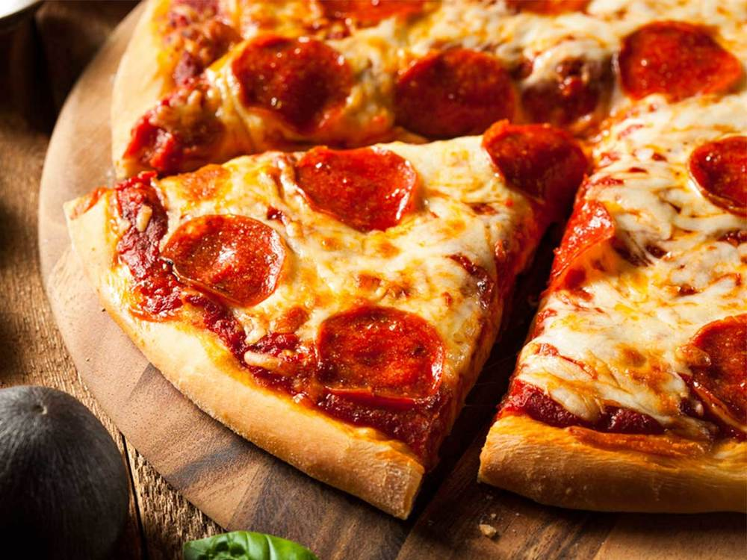
Energy Consumption
Entropy
Output
Waste heat:
2x10¹² W
~66% wasted
Energy Input
Work Output
Economy
GDP and $$$
3x10¹² W (3 TW)
~10,000W per person!
1x10¹² W
~34% used

Slide 6
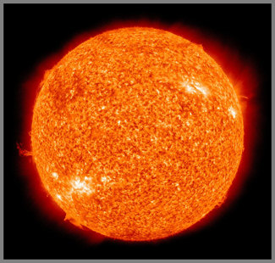
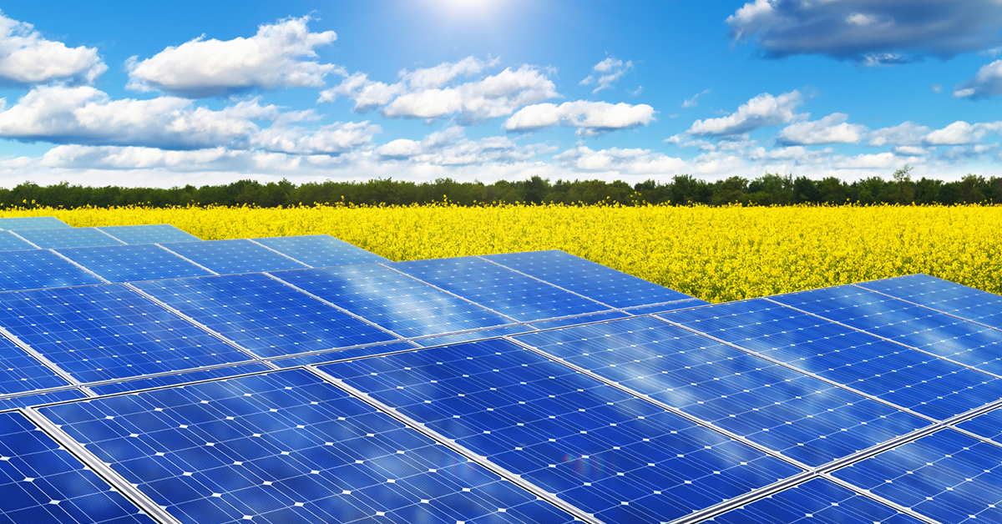
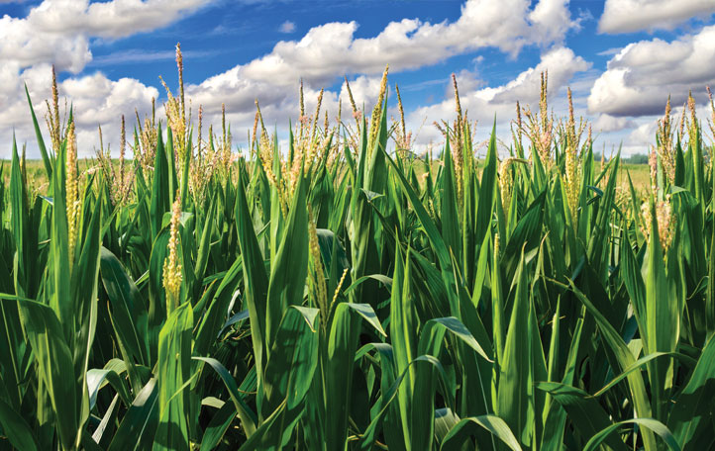
A6 and A7 - Solar Panels
173 Million GigaWatts of power are incident on planet earth!
10,000 times more than total human consumption.

Slide 7
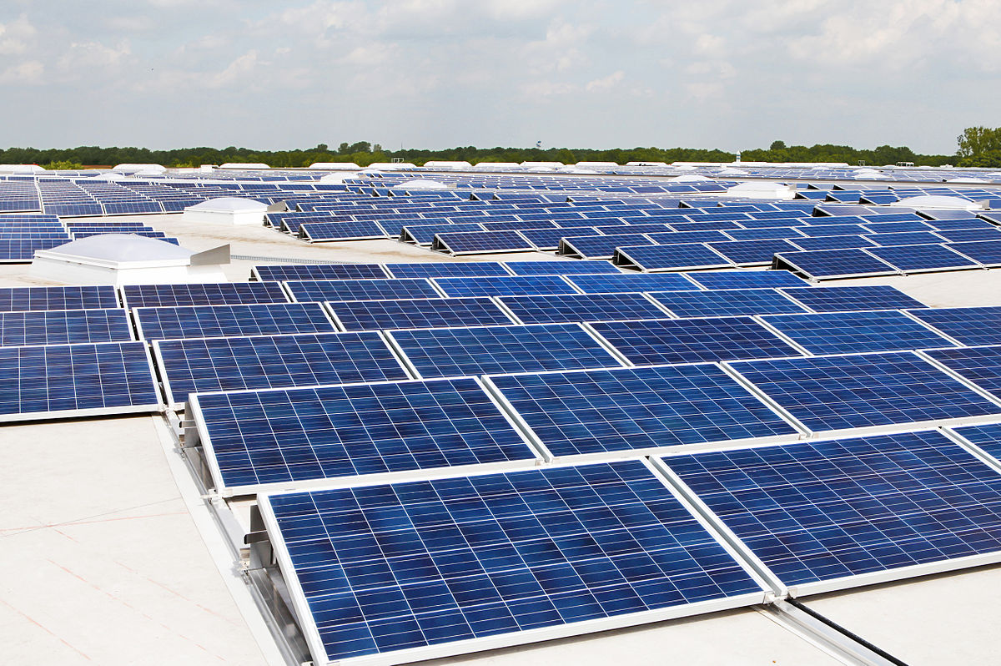
A6/A7 – Solar Panels

Slide 8
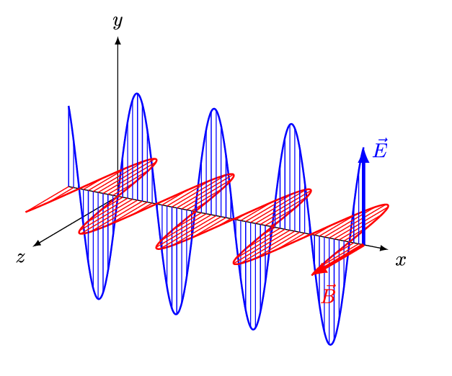
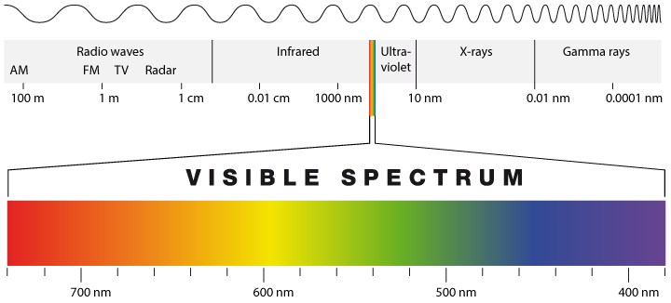
What is Light?
Light is an electromagnetic wave that travels at the speed of light.
“Visible Light” has a wavelength in the 400 – 700nm range.
Wavelength determines color.

Slide 9
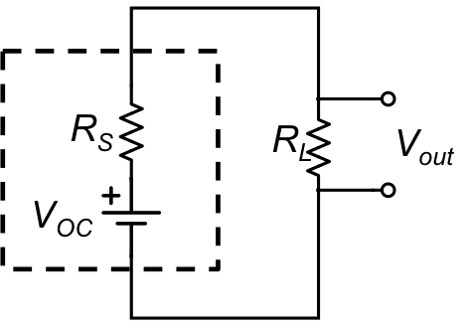
Non-ideal Power Supply
Solar panel is a non-ideal power supply
Voltage “Droop”

Slide 10
Non-ideal Power Supply
Power output depends on load resistance R_{L}
q_{L}
Max power occurs when
R_{L} = R_{S}
“Impedance matching”
R_{L}

